Slide 1
Computer Basics
Mr. Chu
MPHS
CIS 1

Slide 2
Objectives
Define the term computer and discuss the four basic computer operations: input, processing, output, and storage.
Define data and information
Identify computer hardware and peripheral devices
Explain the difference between system software and application software

Slide 3
Objectives (cont’d)
Define Operating System
Explain the different types of computers
Explain how to purchase and keep a computer in good working order

Slide 4
Lesson 1: What is a computer?

Slide 5
What is a Computer?

Slide 6
EQ: What is a computer?
Answer:
A computer is an electronic device that performs the information processing cycle, which consists of four basics functions: input, processing, output, and storage.
Generally, the term is used to describe a collection of devices that function together as a system.

Slide 7
Information Processing Cycle
Input - accept data
Processing - processes data
Output - produces output
Storage - stores results
These 4 computer operations are known as the Information Processing Cycle.
The Information Processing Cycle

Slide 8
Input
Input: The first function of the information-processing cycle, enables the computer to accept data.
Data refers to facts that are raw and unorganized. Information is a collection of data.
Information is entered into the computer for processing through the use of input devices.

Slide 9
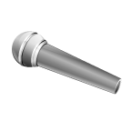
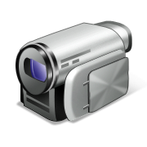
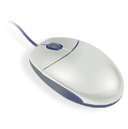
Input Devices
Input Devices
Keyboard
Pointing Device (mouse, game controller, etc..)
Touchscreen
Microphone
Digital Camera
Web Cam
Scanner
Credit Card Reader

Slide 10
Processing
Processing: The second function of the information-processing cycle, converts data into information.
Information refers to simplified, organized, processed data.
The central processing unit (CPU) processes the data into information.

Slide 11
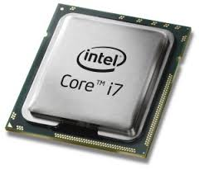
Processing Device
The CPU is like the brain of the computer. It tells the other parts what to do.

Slide 12
Output
Output: The third function of the information-processing cycle, displays processed data that users can understand.
Output devices include monitors, speakers, and printers.

Slide 13
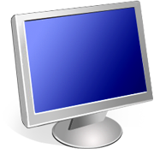
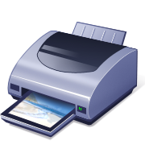
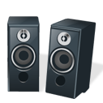
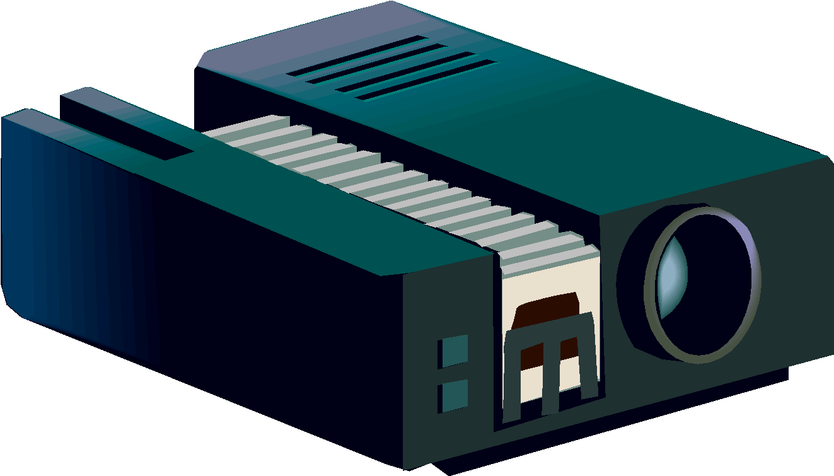
Output Devices
Output Devices
Speakers
Headphones
Monitors
Printers
GPS
Sound Cards
TV
Video Cards

Slide 14
Storage
Storage is the fourth function of the information-processing cycle.
A storage device is any type of hardware that stores data.
The most common is a hard drive, which nearly all computers have,
Two Types of Memory - Random Access Memory (RAM) AND Read-Only Memory (ROM)

Slide 15
RAM Memory
Random Access Memory or RAM is temporary storage memory which hold information for short periods and only when the computer is on.

Slide 16
ROM Memory
Read-Only Memory or ROM are long term storage memory and holds information for as long as you want it.

Slide 17
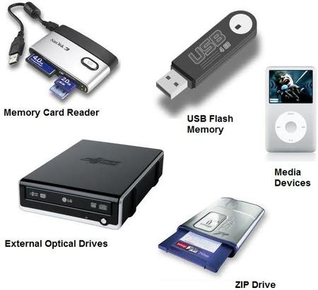
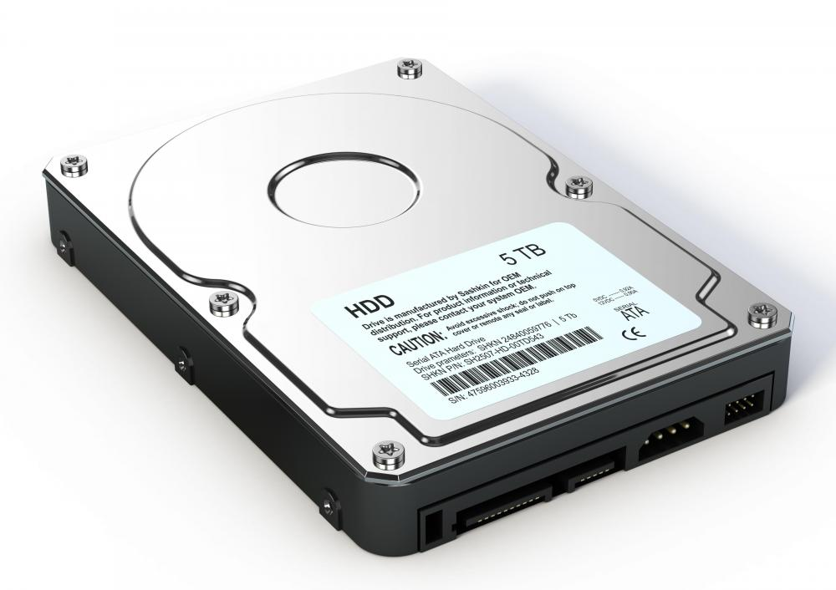
Storage Devices
Hard Drive
These devices let you save and store files for future use.

Slide 18
Lesson 2: Computer Components

Slide 19
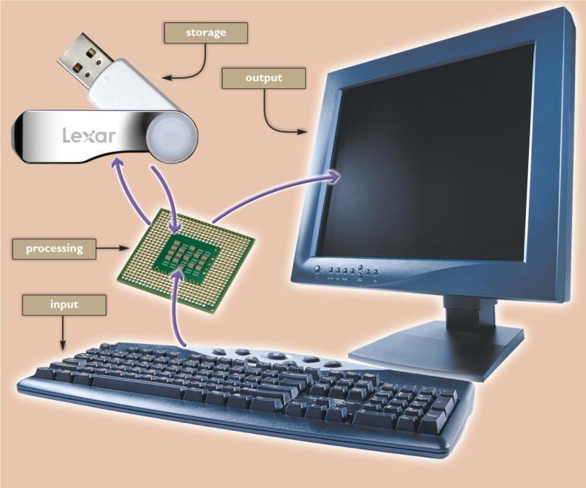
Computer System
Computer system components are categorized into two main groups:
Hardware
Software

Slide 20
Hardware & Software
Hardware is made up of the physical parts of the computer, including such components as the system unit, monitor, keyboard, and printer.
Software is made up of all the programs that instruct the computer.

Slide 21
Basic Parts of a Computer

Slide 22
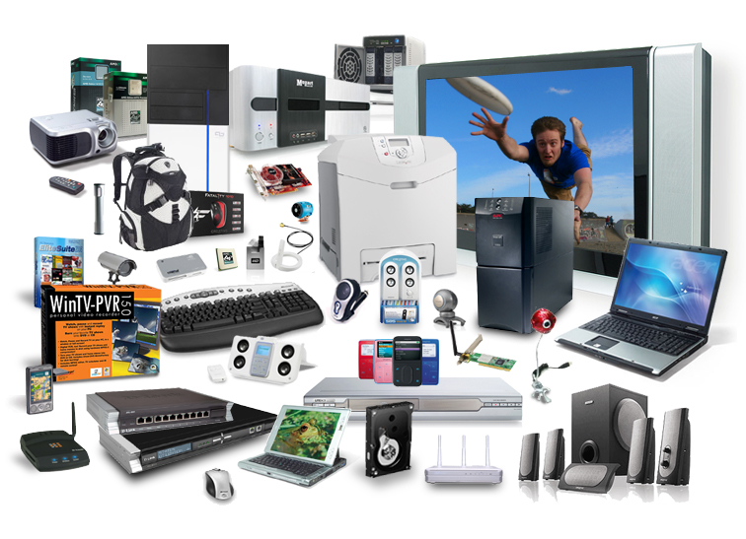
Computer Hardware
You can see and touch computer hardware.

Slide 23
Inside a System Unit

Slide 24
Buttons & Ports

Slide 25
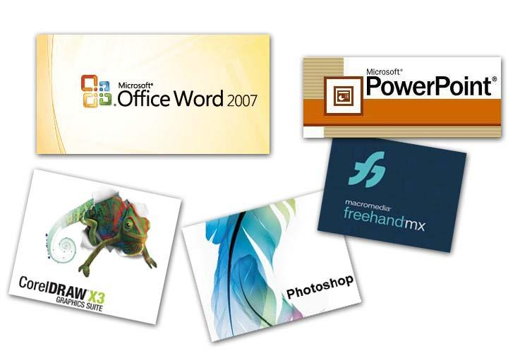
Computer Software
Software are computer programs, also know as applications or APPS

Slide 26
Types of Software
System Software - The most important software. It is a type of computer program that is designed to run a computer's hardware and application programs.
Application Software - These are programs that enable the user to complete tasks such as creating documents, spreadsheets, databases, and publications, doing online research, sending email, designing graphics, running businesses, and even playing games!

Slide 27
Operating System Software

Slide 28
Application Software

Slide 29
Lesson 3: Types of Computers

Slide 30
Types of Computers
There is a computer almost every use and it comes in all shapes and sizes.
PCs (personal computers)
Servers
Main Frame
Supercomputers

Slide 31
PCs (Personal Computers)
Desktops
Laptops/Notebooks
Smart Phones
Tablets
Computers designed for everyday personal use.

Slide 32
Server Computers
Serve information to other computers (clients).
Clients computers connect to a server through a network.
Different types of servers
Web Servers
Mail Servers
Game Servers

Slide 33
Main Frame Computers
The workhorse of the business world. A main frame is the heart of a network of computers or terminals which allows hundreds of people to work at the same time on the same data. It requires a special environment - cold and dry.

Slide 34
Super Computers
The supercomputer is the top of the heap in power and expense. These are used for jobs that take massive amounts of calculating, like weather forecasting, engineering design and testing, serious decryption, economic forecasting, etc.
Top 10 Supercomputers

Slide 35
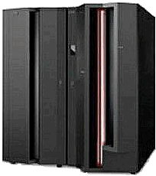
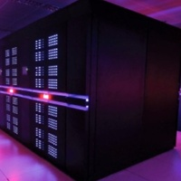
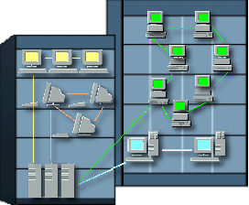
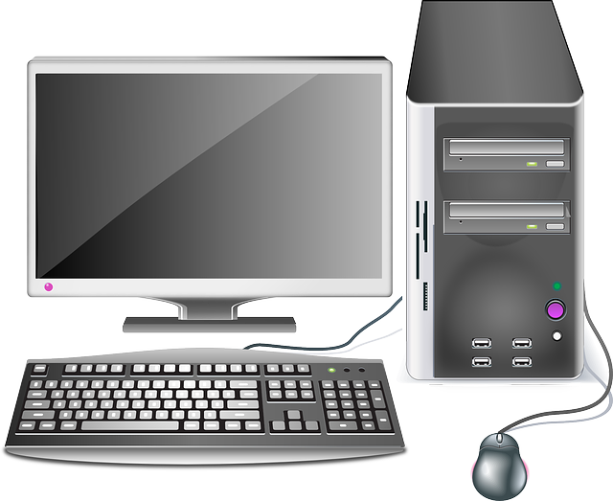
Main Frame
Supercomputer
Servers
Desktop PC

Slide 36
Lesson 4: Computer Safety and Maintenance

Slide 37
Computer Safety & Maintenance

Slide 38
Cleaning Your Computer

Slide 39
Computer Safety & Maintenance
Maintaining a computer involves three things:
Keeping it physically clean,
Protecting it from malware, and
Backing up important files.

Slide 40
Keeping Your Computer Clean
Dust isn't just unattractive—it can potentially destroy parts of your computer. By cleaning your computer regularly, you can help to keep it working properly and avoid expensive repairs.

Slide 41
Protecting Your Computer

Slide 42
Backing Up Important File

